Slide 1
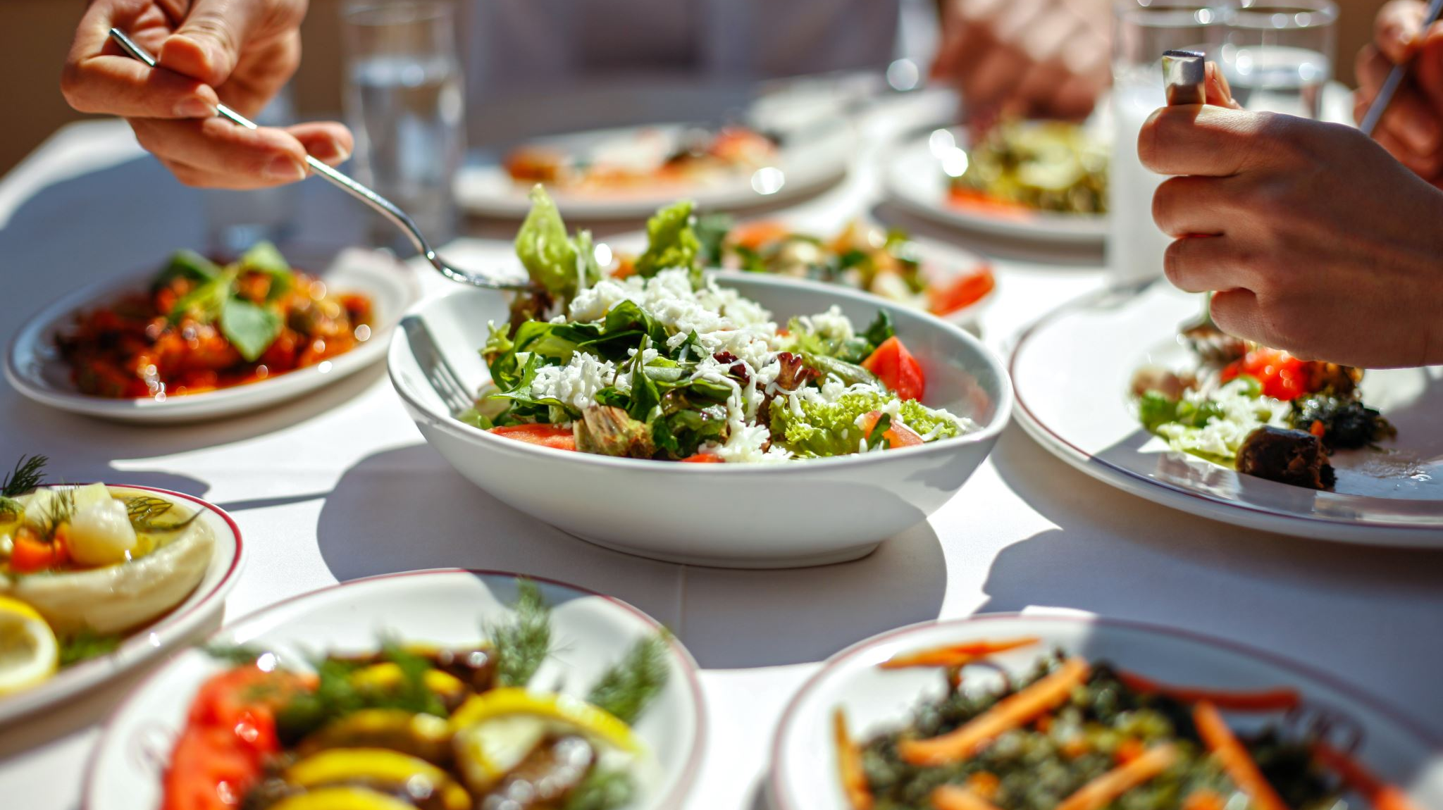






Food
Project V-975
Project Workshop by Udele is licensed under CC BY-NC 4.0
Project Workshop by Udele is licensed under CC BY-NC 4.0

Slide 2
Let’s talk about food!
Johanna is a vegan food influencer.
In this video she shares what she eats in a day to feel good.
Watch the video and think about:
  What is healthy about this diet?
  Would you do anything differently?
https://www.instagram.com/reel/DHbdif3MC5C/?utm_source=ig_web_copy_link&igsh=MzRlODBiNWFlZA==
Notes:
What to talk about:
Most of the food itself is healthy, but the doses are important! Bananas are a healthy alterative to sweets but still have an incredible amount of sugar! Joahnna adds NINE bananas to her smoothie AND Kokusblütenzucker. One banana has around 90kcal, meaning she already has an intake of at least 810kcal (not counting the rest of the ingredients) for breakfast. The average woman her age has a daily calorie requirement of 1.900kcal. Lunch is fine, lots of vegetables, rather large portions though, and the pudding with date cake adds an extra couple hundred kcal.

Slide 3
Sort the Food
Work with a partner.
Sort the words into the correct category: Write the English words from the list below into the correct column.
How many languages can you use? In how many other languages do you know the word? Add these words to the box.
apple, chicken, grapes, onions, bananas, milk, beef, oranges, potatoes, cheese, carrots, yogurt, butter, fish, peas
Fruit | Vegetables | Dairy | Meat | Fish

Slide 4
Sort the Food
Work with a partner.
Sort the words into the correct category: Write the English words from the list below into the correct column.
How many languages can you use? In how many other languages do you know the word? Add these words to the box.
apple, chicken, grapes, onions, bananas, milk, beef, oranges, potatoes, cheese, carrots, yogurt, butter, fish, peas
Fruit | Vegetables | Dairy | Meat | Fish
Apple | Carrots | Milk | Chicken | Fish
Bananas | Potatoes | Butter | Beef
Oranges | Peas | Yogurt
Grapes | Onions | Cheese

Slide 5
Comparing words
Look at the words in different languages. Do you see any similarities between languages? Are some words very different? Why do you think that is?
Discuss with your partner: What patterns do you notice? Do some languages borrow words from others?

Slide 6
English | German | B/K/S | Spanish | Other languages
Apple | Apfel | Jabuka | Manzana
Banana | Banane | Banana | Plátano
Orange | Orange | Narandža | Naranja
Grapes | Weintrauben | Groždje | Uvas
Peas | Erbsen | Grašak | Guisantes
Onion | Zwiebel | Luk | Cebolla
Potato | Kartoffel | Krompir | Patata
Carrot | Karotte | Mrkva | Zanahoria
Butter | Butter | Puter | Mantequilla
Cheese | Käse | Sir | Queso
Yogurt | Joghurt | Jogurt | Yogur
Milk | Milch | Mlijeko | Leche
Chicken | Hähnchen | Piletina | Pollo
Beef | Rind | Junetina | Ganado
Fish | Fisch | Riba | Pescado

Slide 7
Team Challenge!
There are two teams.
Each team gets a set of food items
Sort them into the right column
But careful: faster does not mean better! To win you need to sort the food fast AND correctly!
Fruits | Vegetables | Dairy Products | Meat | Other

Slide 8
Solution
Fruits | Vegetables | Dairy Products | Meat | Other
Apple | Broccoli | Cheese | Steak | Chips
Banana | Tomato | Milk | Sucuk | Pasta
Kiwi | Onion | Ayran | Lamb | Baklava
Orange | Carrots | Yogurt | Sausage | Rice
Grapes | Potatoes | Feta | Ham | Lentils
Pear | Peas | Butter | Chicken | Fish

Slide 9
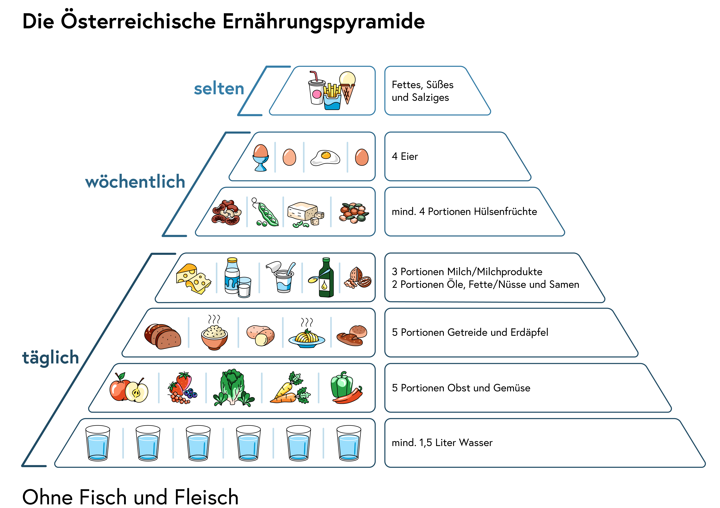
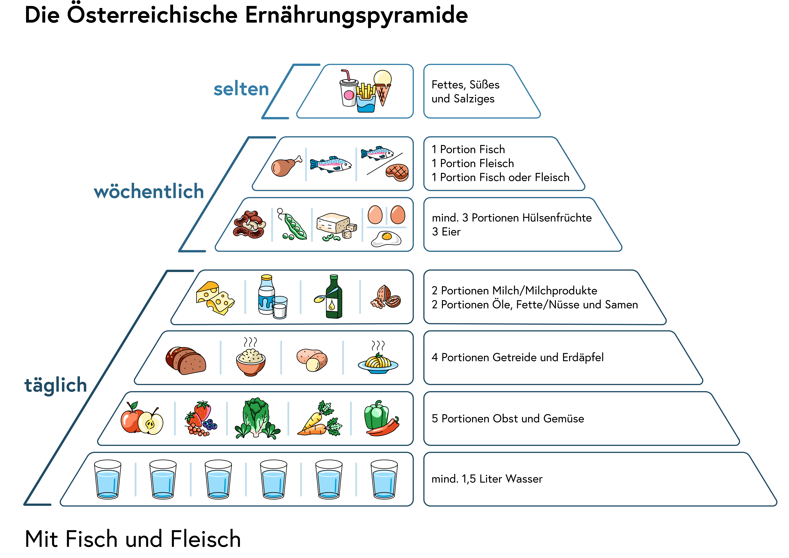
The Food Pyramid
daily
  water
  fruits and vegetables
  grain and potatoes
  dairy products / plant-based fats
weekly
  eggs / legumes
  fish / meat (or more eggs and legumes if vegetarian)
scarcly
  fatty, sweet, salty foods
Ressource: https://www.sozialministerium.at/Themen/Gesundheit/Ernährung/Österreichische-Ernährungsempfehlungen-NEU.html

Slide 10
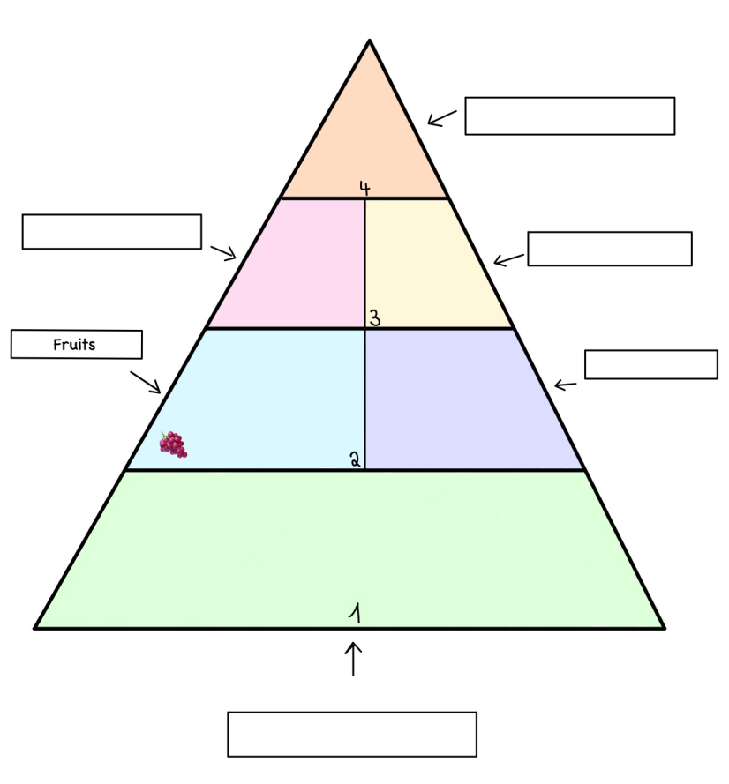
Create your own food pyramid!
Write down your favourite foods and what you eat most often
The foods you eat most often belong to the bottom of the pyramid and those you eat the least at the top!

Slide 11

What is Sustainability? - Deutsch

Slide 12
What is Sustainability?
Sustainability = Long-term care
"Sustainability means using things in a way that they can last a long time. Imagine you have a fruit tree. If you pick all the fruit right away, you won’t have any more fruit in the future. But if you pick only a few fruits and leave the tree to grow, you can enjoy fruit for many years. This is sustainability—using things slowly and carefully so they last longer."
Less sustainable = Short-term harm
"Something is less sustainable when we use too much of it too quickly. For example, if we throw away too much food or use plastic bottles and don’t recycle them, we make the Earth sick. This harms the environment and makes resources like water, trees, or land harder to find in the future."

Slide 13
What is Sustainability? – Word Bank
English | German | BKS | Other Languages
sustainability | Nachhaltigkeit | Održivost
responsible | verantwortlich | odgovoran
consumption | Konsum | Potrošnja
production | Produktion | Produkcija
resources | Ressourcen | Resursi
environment | Umwelt | Okoliš
destructive | zerstörerisch | destruktivan
economy | Wirtschaft | Ekonomija

Slide 14
Local vs. Global Food
What is local and global food?
  Local food is regionally produced food. This means that it is food which is produced in the country we live in. Depending on the time of the year, some foods can be grown and others not. This is what we call seasonal fruits and vegetables.
  Global food can be imported (zu uns gebracht / importiert) from countries all over the world. These are foods we cannot grow in our own country because the weather conditions (Wettervoraussetzungen) are not right. This is why we can eat foods like bananas and avocados all year round.

Slide 15
Local vs. Global Food
Look at the food items below. Write them in the correct column.
🍏 Apple, 🍌 Banana, 🥖 Bread, 🍫 Chocolate, 🍓 Strawberries, 🍚 Rice, 🥕 Carrots, 🥑 Avocado
Food Item | Local (near us) | Global (from far away)
Apple 🍏
Banana 🍌
Bread 🍞
Chocolate 🍫

Slide 16
Local vs. Global Food
Talking about global and local food:
This food is local because it comes from __.
This food is global because it comes from __.
Local food is better because __.
Global food is important because __.
Food Item | Local (near us) | Global (from far away)
Apple 🍏 | ✅ | ❌
Banana 🍌 | ❌ | ✅
Bread 🍞 | ✅ | ❌
Chocolate 🍫 | ❌ | ✅

Slide 17
Plant-based vs. Animal-based Food
Food Item | Plant-based | Animal-based
Corn🌽
Apple🍎
Bread 🍞
Rice🌾
Nuts🥜
Eggs🥚
Cheese🧀
Meat🥩
Milk🥛
Fish🐟
Sort the food items below into the correct group.
🌽 Corn, 🍞 Bread, 🍎 Apple, 🌾 Rice, 🥜 Nuts, 🥚 Eggs, 🧀 Cheese, 🥩 Meat, 🥛 Milk, 🐟 Fish

Slide 18
Local vs. Global Food
Food Item | Plant-based | Animal-based
Corn🌽 | ✅ | ❌
Apple🍎 | ✅ | ❌
Bread 🍞 | ✅ | ❌
Rice🌾 | ✅ | ❌
Nuts🥜 | ✅ | ❌
Eggs🥚 | ❌ | ✅
Cheese🧀 | ❌ | ✅
Meat🥩 | ❌ | ✅
Milk🥛 | ❌ | ✅
Fish🐟 | ❌ | ✅
Talking about plant-based and animal-based food:
__ is plant-based because it comes from __ (a tree, a plant, the ground).
__ is animal-based because it comes from __ (a cow, a chicken, a fish).
I eat more __ food because __.
Word Comparison:
English: plant, animal
German: Pflanze, Tier
Turkish: bitki, hayvan
BKS: biljka, životinja

Slide 19
Sustainability of Meat
Look at the table. Which foods use the most water?
Talking about the sustainability of meat:
Making __ uses more water than __.
If we eat less __, we save more __.
Eating __ is better for the environment because __.
Food | Water Used (liters per kg)
🍔 Beef | 15,000 L
🐔 Chicken | 4,300 L
🌾 Rice | 2,500 L
🍎 Apples | 822 L
English | German | Turkish | BKS
Meat | Fleisch | et | meso
Water | Wasser | su | voda
Environment | Umwelt | çevre | okolina
Save | sparen | tasarruf etmek | štedjeti

Slide 20
Sustainability of Meat
Does this mean, you should stop eating meat? No.
There are other foods than meat, which use up a lot of water or need woods to be stubbed (gerodet).
The important thing is:
  You should think about how often you eat something and where it comes from.
  The more locally produced and seasonal foods you eat, the better it is for the environment!

